Slide 1
IF AND NESTED IF IN JAVA
ALEX J MATHEW

Slide 2


IF AND NESTED IF IN JAVA
Welcome to the presentation on "if and Nested if Statements in Java.

Slide 3
Questions
Thank you for your attention. It's now time for any questions or clarifications

Slide 4
IF

Slide 5
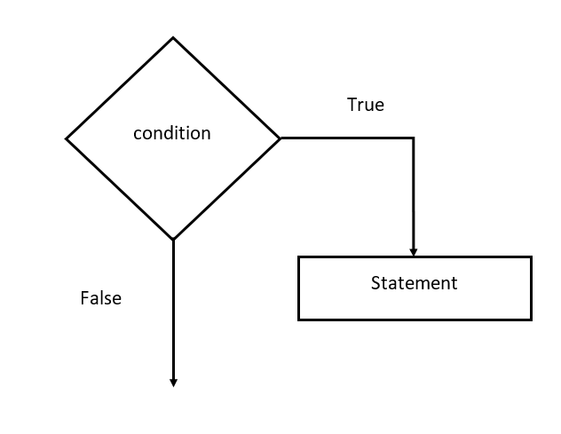
IF STATEMENT
The "if" statement is one of the fundamental conditional statements in Java.
It allows us to execute a block of code only if a specified condition is true.
Syntax: `if (condition) {
code block
}

Slide 6
SAMPLE PROGRAM
int x = 10;
if (x > 5) {
System.out.println("x is greater than 5");
}

Slide 7
NESTED IF

Slide 8
NESTED IF
You can nest "if" statements within each other to handle multiple conditions.
This creates a decision tree where one condition depends on another.
Syntax:
if (condition1) {
// code block for condition1
if (condition2) {
// code block for condition2
}
}

Slide 9
SAMPLE PROGRAM
int x = 5;
int y = 10;
if (x > 0) {
System.out.println("x is positive.");
if (y > 0) {
System.out.println("y is also positive.");
}
}

